Slide 1
Challenges
Mini challenge 1

Slide 2
Challenge 1
This activity is intended for the student to review the concepts introduced this week.
The activity consists of creating two nodes.
The first node will act as a simple signal generator. That will generate a sinusoidal signal.
The second node will act as a “process”, which will take the signal generated by the previous node and modify it, generating a “processed signal”.
Both signals must be plotted using the rqt_plot.
Different terminals must show the information of the generated signals (use it to debug).
A launch file must be generated to launch both nodes, terminals and rqt_plot at the same time.

Slide 3
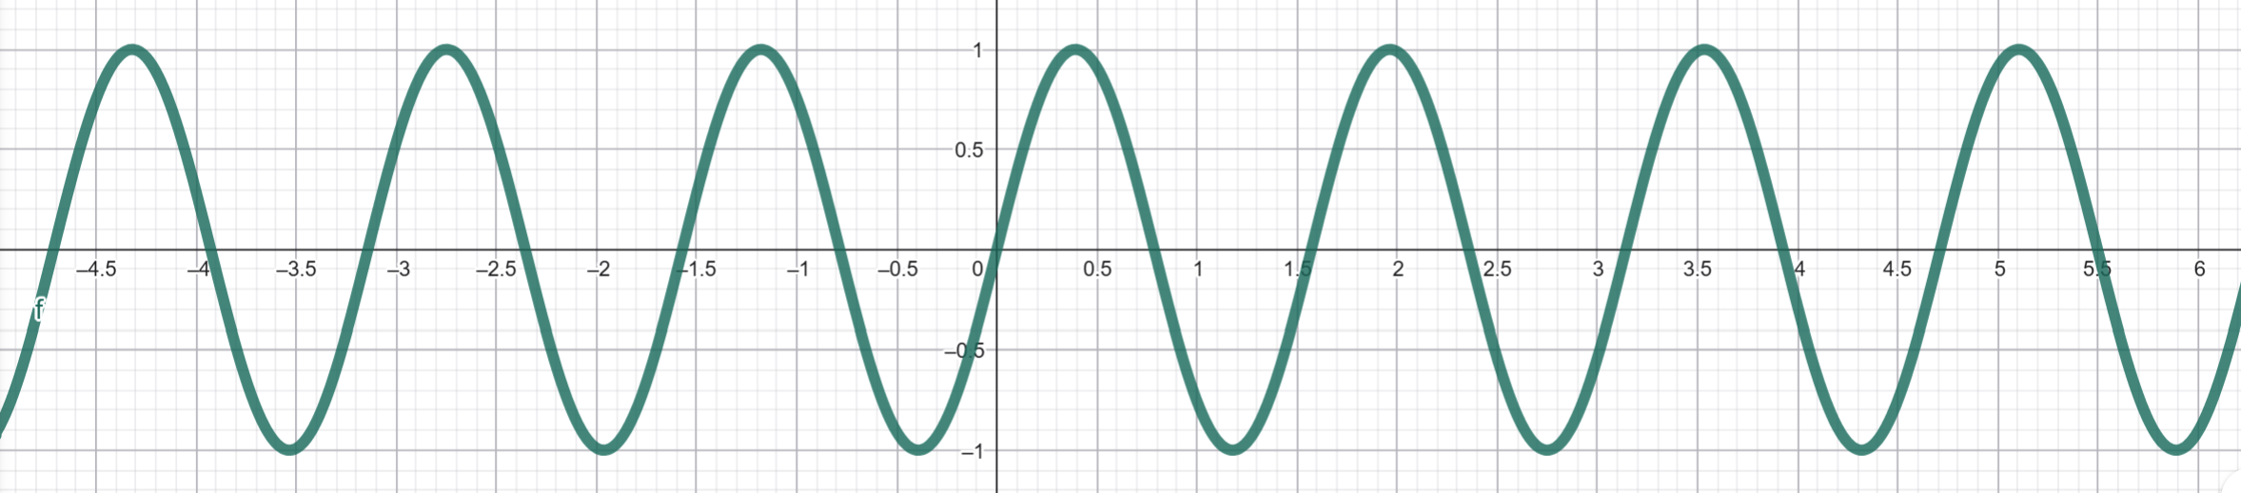

Challenge 1
The Signal Equation
Amplitude: The vertical height from the center line of the wave to a peak.
Frequency: The number of cycles that happen within the time period.
Phase: The horizontal sliding of the wave to the left or right from its standard position.
Offset: The vertical sliding of the wave to the left or right from its standard position.
$$y\left(t\right)=A\sin\left(wt+φ\right)+B$$
Amplitude
Phase
Frequency
Offset

Slide 4
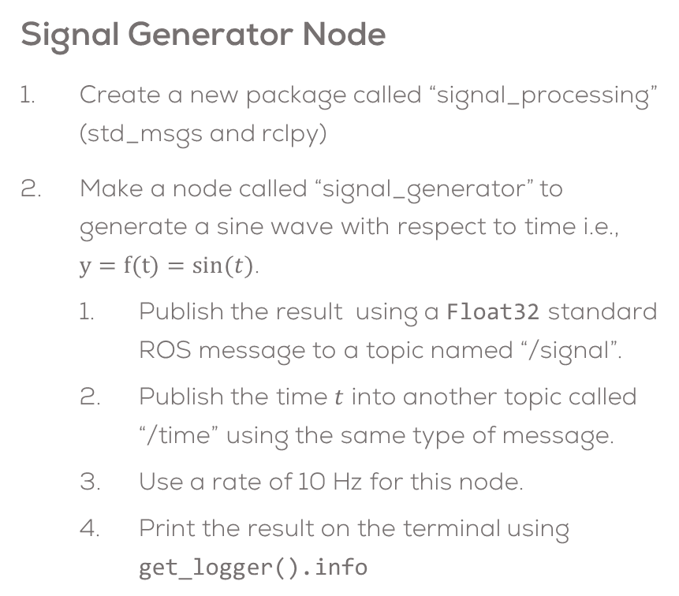
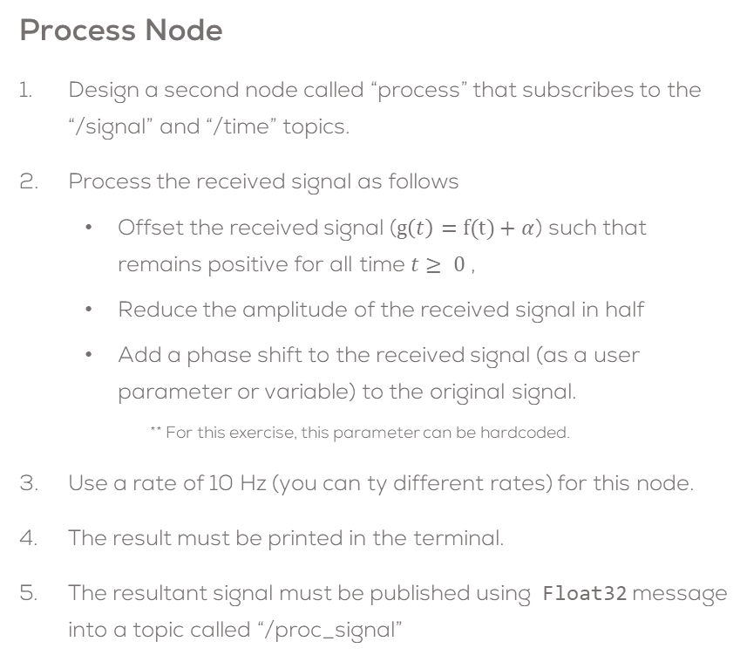
Challenge 1 – Part 1
Signal Generator Node
Create a new package called “signal_processing” (std_msgs and rclpy)
Make a node called “signal_generator” to generate a sine wave with respect to time i.e., $y=f(t)=sin⁡(t)$.
  Publish the result using a Float32 standard ROS message to a topic named “/signal”.
  Publish the time $t$ into another topic called “/time” using the same type of message.
  Use a rate of 10 Hz for this node.
  Print the result on the terminal using get_logger().info
Process Node
Design a second node called “process” that subscribes to the “/signal” and “/time” topics.
Process the received signal as follows
  Offset the received signal ($g\left(t\right)=f(t)+α$) such that remains positive for all time $t≥ 0$ ,
  Reduce the amplitude of the received signal in half
  Add a phase shift to the received signal (as a user parameter or variable) to the original signal.
    ** For this exercise, this parameter can be hardcoded.
Use a rate of 10 Hz (you can ty different rates) for this node.
The result must be printed in the terminal.
The resultant signal must be published using Float32 message into a topic called “/proc_signal”

Slide 5
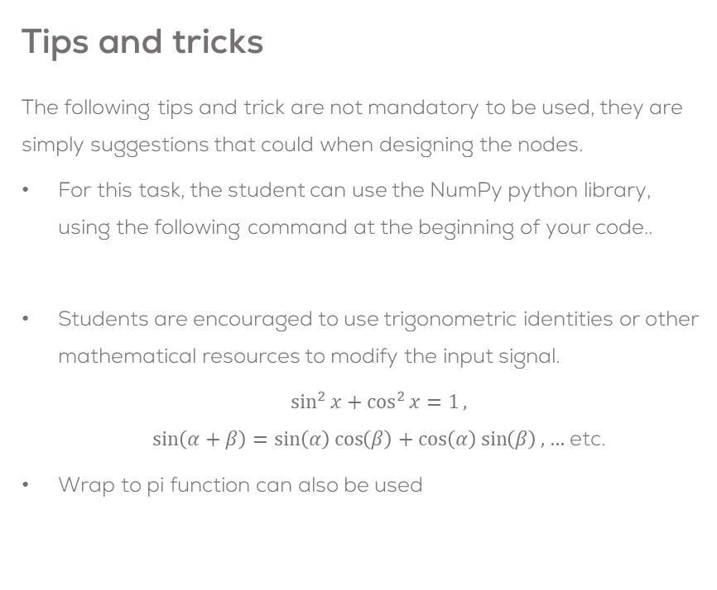
Challenge 1 – Part 1
Launch File and Plotting
Use the ROS tool “rqt_plot” to plot both signals.
  ros2 run rqt_plot rqt_plot
Make a Launch file to execute both nodes at the same time.
  The Launch file must open the rqt_plot and plot both signals in the same window.
* You can use the following code in the launch file to open the rqt_plot, showing the data on the topics.
Tips and tricks
The following tips and trick are not mandatory to be used, they are simply suggestions that could when designing the nodes.
  For this task, the student can use the NumPy python library, using the following command at the beginning of your code..
  Students are encouraged to use trigonometric identities or other mathematical resources to modify the input signal.
    $\sin^{2}{x+\cos^{2}{x}=1},$
    $\sin\left(α+β\right)=\sin\left(α\right)\cos\left(β\right)+\cos\left(α\right)\sin\left(β\right), …$ etc.
  Wrap to pi function can also be used
import numpy as np
rqt_node = Node(name='rqt_plot',
package='rqt_plot',
executable='rqt_plot',
arguments=['/signal/data', '/proc_signal/data']
)

Slide 6
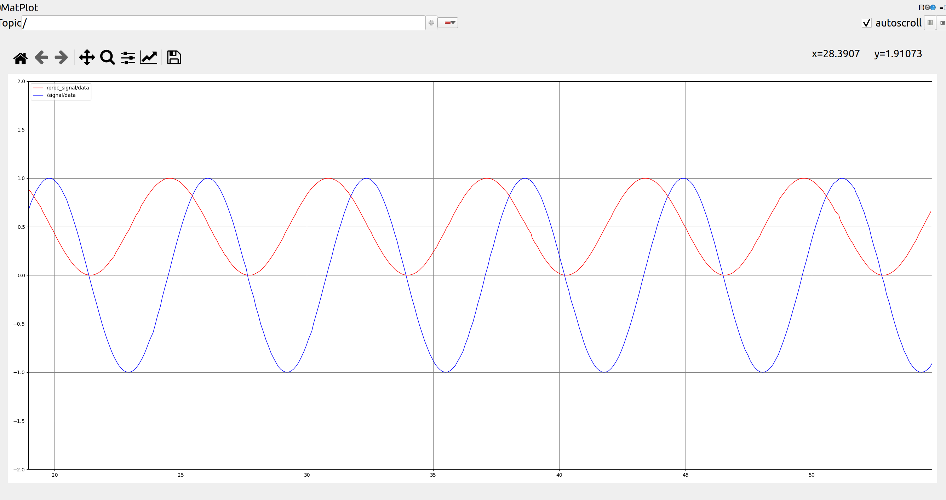
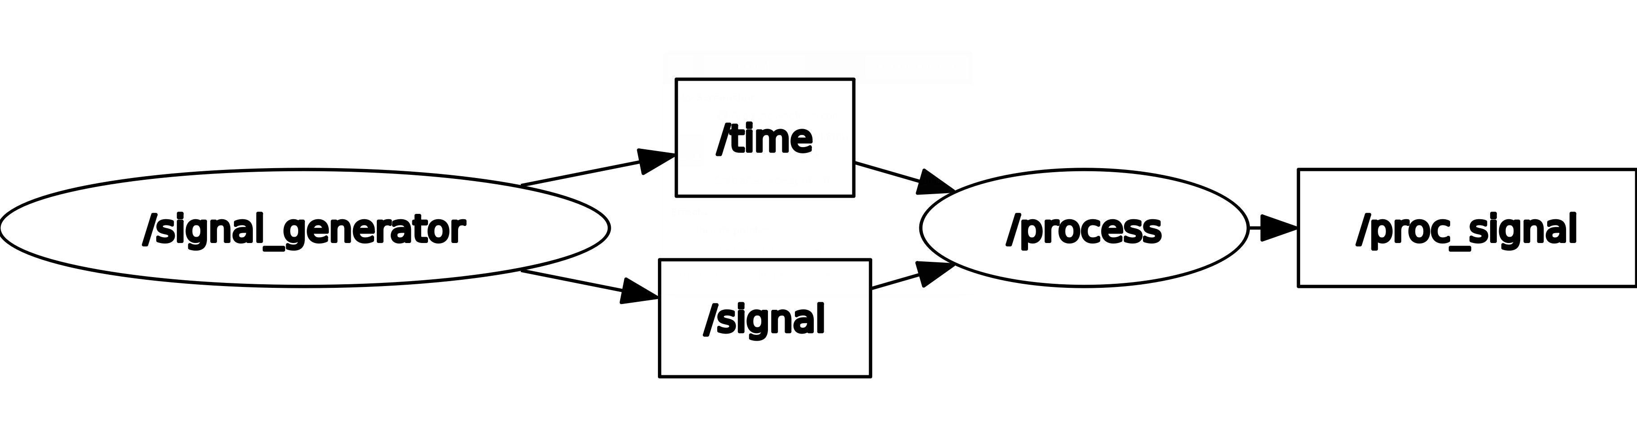
Challenge 1 – Part 1
(expected results)
Nodes displayed using rqt_graph
Resultant signals displayed using rqt_plot

Slide 7

Challenge 1 – Part 2
Signal Generator Parameters
Include parameters to modify the signal generator in run-time using the terminal.
The signal generator node parameters must be set in the launch file or as a config file (YAML).
The user must be able to tune the parameter at runtime, and if a parameter is incorrect, the node must let the user know.
$$y\left(t\right)=A\sin\left(wt+φ\right)+B$$
Amplitude
Phase
Frequency
Offset
'amplitude': 0.01, #Signal amplitude
'frequency': 2.16, #Signal frequency
'phase': 0.05, #Signal phase
'offset': 0.0, #Signal offset
It is strictly forbidden to use any other python library, other than NumPy. The controller must be made without using any predefined online controllers.

Slide 8
Rules
This is a challenge not a class. The students are encouraged to research, improve tune explain their algorithms by themselves.
MCR2(Manchester Robotics) Reserves the right to answer a question if it is determined that the question contains partially or totally an answer.
The students are welcome to ask only about the theoretical aspect of the class.
No remote control or any other form of human interaction with the simulator or ROS is allowed (except at the start when launching the files).
It is forbidden to use any other internet libraries with the exception of standard libraries or NumPy.
If in doubt about libraries please ask any teaching assistant.
Improvements to the algorithms are encouraged and may be used as long as the students provide the reasons and a detailed explanation on the improvements.
All the students must respect each other and abide by the previously defined rules.
Manchester Robotics reserves the right to provide any form of grading. Grading and grading methodology are done by the professor in charge of the unit.

